Slide 1


UNIVERSITY INSTITUTE OF ENGINEERING
Academic Unit V
Bachelor of Engineering
(Computer Science & Engineering)
Biology For Engineers
23SZT-148
Gene Interaction and Gene Mapping
DISCOVER . LEARN . EMPOWER

Slide 2
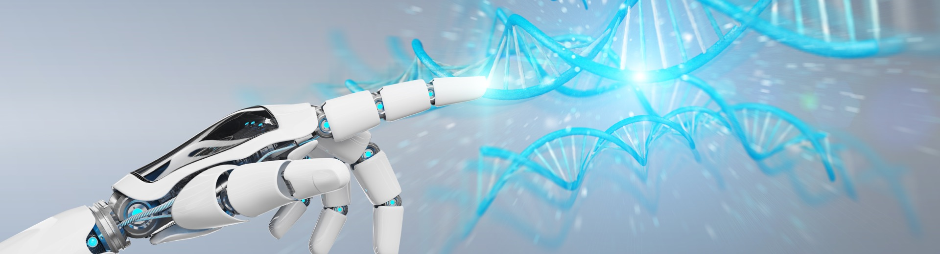
INTRODUCTION
Course Objective
This subject is designed to impart fundamental knowledge on basic of genetics and emerging fields of biology like biomedical recording system and medical instrumentation.
It is designed to impart knowledge that how to apply basics of biology in engineering.
https://www.uic.es/sites/default/files/uic-grau-bioenginyeria-hero-header_1.jpg

Slide 3

INTRODUCTION
Space for visual (size 24)
Course Outcome
CO Number | Title | Level
CO1 | Identify the biological concepts from an engineering perspective. | Knowledge
CO2 | Development of artificial systems mimicking human action. | Understand
CO3 | Explain the basic of genetics that helps to identify and formulate problems | Analyze
CO4 | Apply knowledge of measurement system, biomedical recording system and biosensors to excel in areas such as entrepreneurship, medicine, government, and education. | Apply
CO5 | Integrate biological principles for developing next generation technologies, | Create
Will be covered in this lecture
https://specials-images.forbesimg.com/imageserve/1034901762/960x0.jpg?fit=scale

Slide 4
SYLLABUS
Unit-1 | Importance of Biology In Engineering | Contact Hours: 15
Chapter 1 Significance of Biology in Engineering Chapter 2 Genetics | Introduction: Fundamental Differences between Science and engineering by drawing a comparison between eye and camera, Bird flying and aircraft. Significance of Biology in Engineering, Discuss how biological observations of 18th Century that lead to major discoveries, Examples from Brownian motion and the origin of thermodynamics by referring to the original observation of Robert and Julius Mayor. Genetics: Mendel’s laws, Concept of segregation and independent assortment, concept of allele, gene mapping, Gene interaction, Epitasis, Meiosis and Mitosis as a part of genetics. Mechanism of how genetic material passes from parent to offspring. Concepts of recessiveness and dominance. Concept of mapping of phenotype to Genes, single gene disorders in humans, concept of complementation using human genetics.

Slide 5
Gene Interaction and Gene Mapping

Slide 6
Gene Interaction

Slide 7
We know that many characteristics are passed on through genes.
Mendel and other workers assumed that characters are governed by single genes but later it was discovered that one characters are governed by two or more genes (polygenic traits).
Most of the characteristics are not passed on through one gene with only two alleles or they are caused by multiple alleles where a single gene has more than two possible alleles.
This can make inheritance very complicated.

Slide 8
Gene Interaction
The term genetic interaction (GI) covers a group of functional relationships between genes.
Most of the characters of living organisms are controlled/influenced/governed by a collaboration of several different genes.
The phenomenon of two or more genes affecting the expression of each other in various ways in the development of a single character of an organism is known as gene/genetic interaction.
Gene interaction produces novel phenotypes.

Slide 9
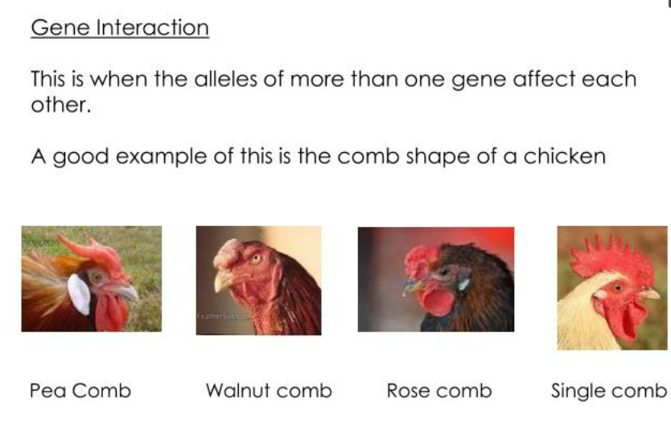

Slide 10
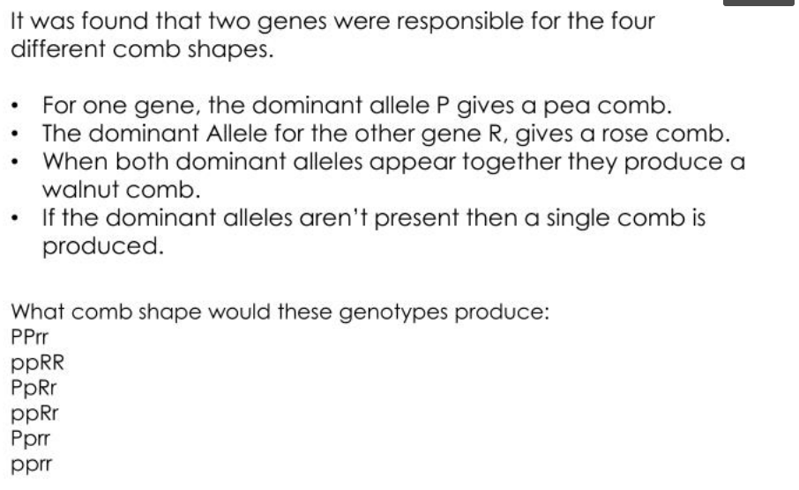
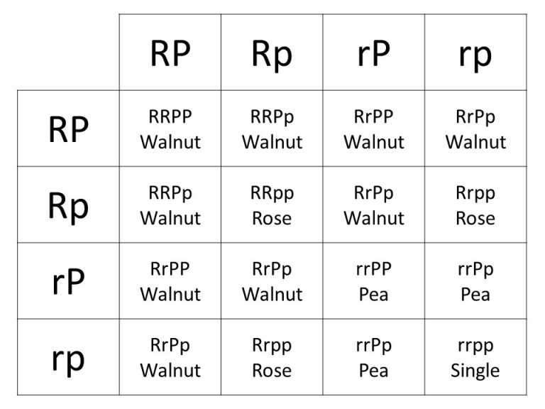

Slide 11
Types of Gene Interaction
Gene interactions can be classified as:
Allelic gene interaction (non epistatic gene interaction/intra-allelic interaction/Intra-genic interaction):
The alleles of the same gene interact in such a way to produce the new character.
Incomplete dominance
Co-dominance
Non-allelic (Inter-allelic/Inter-genic interaction) gene interaction or epistatic gene interaction
The independent gene located on same or different chromosomes interact with one another for expression of single phenotypic trait.
Epistasis

Slide 12
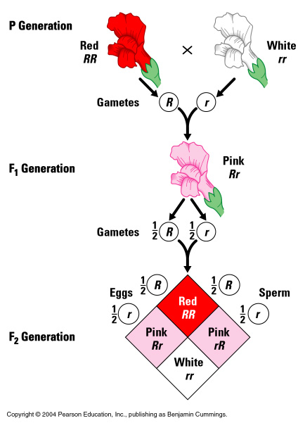
Incomplete Dominance
Antirrhinum majus
Incomplete dominance is a partial expression of alleles in heterozygous condition
Hybrid show a intermediate phenotype instead of one of the parents
In F2 generation genotypic ratio is 1:2:1 but phenotypic ratio is also 1:2:1

Slide 13
Incomplete Dominance
Incomplete dominance is when neither gene that determines a trait dominates, so the recessive trait is not fully hidden.
The result is a “mixed” genetic trait that is neither dominant nor recessive.
Example: Red (RR) x White (WW) flowers yield Pink (RW)
RR = red
WW = white
RW = pink

Slide 14
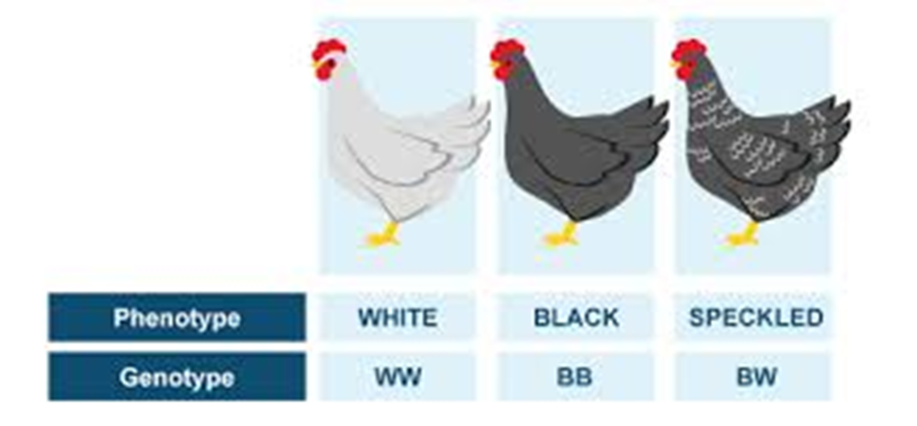
CODOMINANCE
It is simultaneous and equal expression of alleles in heterozygous condition, so that hybrids have phenotype different from homozygous parents.
Both the dominant alleles are expressed in the heterozygous individual
Both traits are dominant, and show up in the phenotype together. Co means “together”

Slide 15

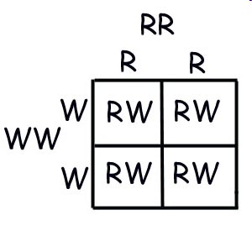
Codominance Example: Rhodedendron
R = allele for red flowers
W = allele for white flowers
Cross a homozygous red flower with a homozygous white flower.

Slide 16
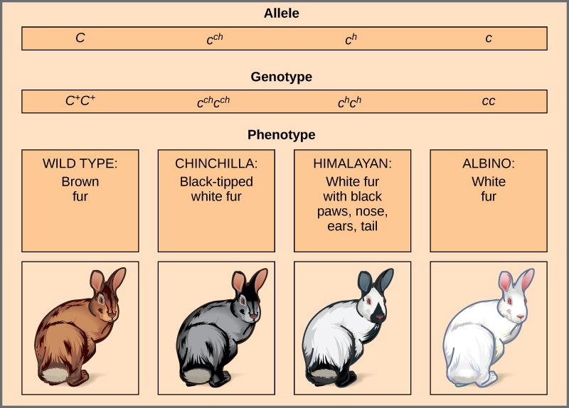
MULTIPLE ALLELES
When there is more than 2 alleles possible for a given gene.
Allows for a larger number of genetic and phenotypic possibilities.
Several dominant alleles and/or recessive alleles can be combined to create multiple phenotypes.
There may be many alleles of gene in a particular population but in diploid individual only two allele of a gene are present on same location of homologous chromosome.

Slide 17
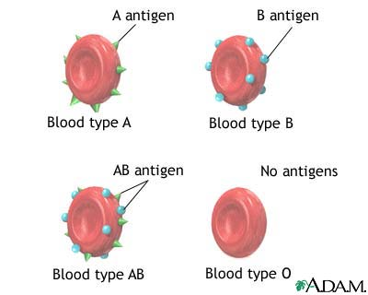
Blood Type
Blood type consists of two dominant and one recessive allele in humans
Blood types are A, B, O, and AB.
AB blood is a co-dominant trait.
There is a recessive allele for type O.
Type A and B show regular dominance over this recessive allele.
Thus, the only way to be type O is to be homozygous recessive.

Slide 18

Blood type displays both Co-dominance and Complete dominance
Red Blood cells can either have a carbohydrate on their surface or not.
The presence of a carbohydrate (I) is dominant to the absence of a carbohydrate (i).
Additionally, there are two types of carbs that may exist on the surface of RBCs called A (I^{A}) and B (I^{B}).
Cell surface carbs A and B are codominant, which means they could also show up at the same time on a RBC.

Slide 19
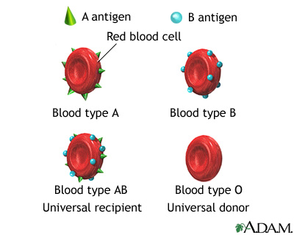
http://www.pennmedicine.org/health_info/images/19450.jpg

Slide 20
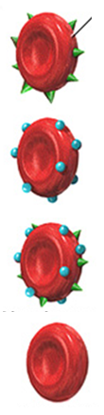
Blood Type Inheritance Rules:
A person with the I^{A} allele will have A carbohydrates.
A person with the I^{B} allele will have B carbohydrates.
A person with the recessive i allele will have no carbohydrates.
Or a person with both I^{A} and I^{B} alleles will have both A and B carbohydrates on their cells.
Cells | Genotypes | Blood types
 | I^{A}i, I^{A}I^{A} | Type A blood
 | I^{B}i, I^{B}I^{B} | Type B blood
 | I^{A}I^{B} | Type AB blood
 | ii | Type O blood

Slide 21
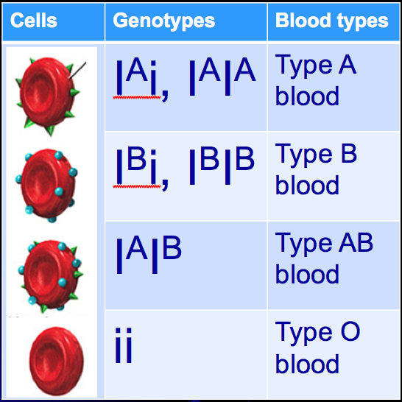
Blood Type Problems
If a woman with AB blood has children with a man who has type O, what will be the possible genotypes of their children?
What will be their blood types?
I^{A}
I^{B}
i
I^{A} i
I^{B} i
i
I^{A} i
I^{B} i

Slide 22
Blood Type Problems
Blood Type Problem 2: A woman with type B blood has a child with type O blood. How is this possible if her husband has type A blood?

Slide 23
Epistasis
Phenomenon of masking or suppressing the expression of gene by another non-allelic gene.
This kind of gene interaction is called epistasis, it was first defined by William Bateson in 1909.
In epistasis, one gene’s alleles mask the effects of another gene’s alleles to result either in the suppression of the effect or they both combine to produce a new trait (character).
A gene or locus which suppressed or masked the action of a gene at another locus was termed suppressor or epistatic gene.
The gene or locus which was suppressed by an epistatic gene was called hypostatic gene.

Slide 24
Difference between Dominance and Epistasis
Dominance
Dominance occurs between two alleles of the same gene
Involves intra-allelic gene interaction.
One allele hides the effect of other allele at the same gene pair.
Epistasis
Epistasis occurs between two genes coding for different characteristics
Involves inter-allelic gene interaction.
One gene hides the effect of other gene at different gene loci.

Slide 25
GENE MAPPING

Slide 26
GENE MAPPING
Gene mapping means the mapping of genes to specific locations on chromosomes
Such maps indicates the positions of genes in the genome and also distance between them
It is very important in the understanding of genetic diseases
Example: sex-linked genes responsible for color-blindness and hemophilia in human beings

Slide 27
GENETIC MAPPING
The first steps of building a genetic map are the development of genetic markers and a mapping population.
Since the closer the two markers are on the chromosome, the more likely they are to be passed on to the next generation together, therefore the "co-segregation" patterns of all markers can be used to reconstruct their order.
The genotypes of each genetic marker are recorded for both parents, and in each individual in the following generations.
The quality of the genetic maps is largely dependent upon these two factors: the number of genetic markers on the map and the size of the mapping population.

Slide 28
Types of Gene Mapping
Genetic Mapping
Based on the use of genetic techniques to construct maps
These maps show the positions of genes and other sequence features on a genome
Also helps to determine the relative position between two genes on a chromosome
Physical Mapping
Uses molecular biology techniques to examine DNA molecules directly
Based on these techniques map construction is done
These maps show the positions of sequence features, including genes

Slide 29
Genetic Mapping
Genetic mapping is based on the use of genetic techniques to construct maps showing the positions of genes and other sequence features on a genome.
Genetic techniques include cross-breeding experiments or,
Case of humans, the examination of family histories (pedigrees)
Requires informative markers- polymorphic and a population with known relationships
Best if measured between ‘close’ markers
Unit of distance in genetic maps= centiMorgans, cM
1cM=% chance of recombination between markers

Slide 30
Physical Mapping
Physical mapping uses molecular biology techniques to examine DNA molecules directly in order to construct maps showing the positions of sequence features, including genes.
Restriction mapping: which locates the relative positions on a DNA molecule of the recognition sequences for restriction endonucleases
Fluorescent in situ hybridization (FISH): in which marker locations are mapped by hybridizing a probe containing the marker to intact chromosomes
Sequence tagged site (STS) mapping: in which the positions of short sequences are mapped by PCR and/or hybridization analysis of genome fragments

Slide 31
Uses of Gene Mapping
Identify genes responsible for diseases.
Heritable diseases
Cancer
Identify genes responsible for traits.
Plants or Animals
Disease resistance
Meat or Milk Production

Slide 32
REFERENCES
Gupta, P.K.. Cytology, Genetics and Molecular Biology, Rastogi Publishers, Meerut, 1993.
Roit I.M., Brostoff J. and Male D. Mosby .Immunology (6 th Edition) by, An imprint of Elsevier Sci Ltd., 2002.
https://nptel.ac.in/courses/121/106/121106008/
https://www.utoledo.edu/engineering/bioengineering/undergrad/prospective/whatisbioe.html#:~:text=Bioengineering%20is%20the%20application%20of,health%20care%20and%20other%20fields.
https://i.pinimg.com/originals/68/c9/30/68c930e95113ceb2e3dfc9de2f164680.png
https://youtu.be/FBUpnG1G4yQ

Slide 33
THANK YOU

